Slide 1
Truncation Errors and the Taylor Series Chapter 4

Slide 2
How does a CPU compute the following functions for a specific x value?
cos(x) sin(x) e^{x} log(x) etc.
Non-elementary functions such as, trigonometric, exponential and others are expressed in an approximate fashion using Taylor series when their values, derivatives, and integrals are computed.
Taylor series provides a means to predict the value of a function at one point in terms of the function value and its derivatives at another point.

Slide 3
Taylor Series (n^{th} order approximation):
The Reminder term, R_{n}, accounts for all terms from (n+1) to infinity.
Define the step size as h=(x_{i+1}- x_{i}), the series becomes:

Slide 4
Any smooth function can be approximated as a polynomial.
Take x = x_{i+1} Then f(x) ≈ f(x_{i}) zero order approximation
first order approximation
Second order approximation:
n^{th} order approximation:
Each additional term will contribute some improvement to the approximation. Only if an infinite number of terms are added will the series yield an exact result.
In most cases, only a few terms will result in an approximation that is close enough to the true value for practical purposes

Slide 5
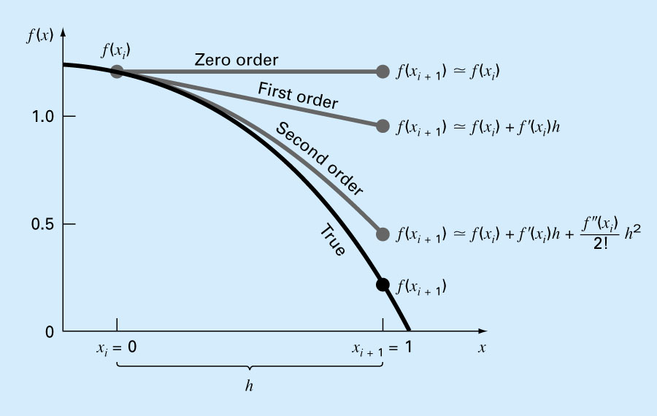
Example Approximate the function f(x) = 1.2 - 0.25x - 0.5x² - 0.15x³ - 0.1x⁴ from x_{i} = 0 with h = 1 and predict f(x) at x_{i+1} = 1.

Slide 6
Example:
computing f(x) = e^{x} using Taylor Series expansion
Choose x = x_{i+1} and x_{i} = 0 Then f(x_{i+1}) = f(x) and (x_{i+1} – x_{i}) = x
Since First Derivative of e^{x} is also e^{x} :
(2.) (e^{x} )” = e^{x} (3.) (e^{x})”’ = e^{x}, … (n^{th}.) (e^{x})^{(n)} = e^{x}
As a result we get:
Looks familiar?
Maclaurin series for e^{x}

Slide 7
Yet another example:
computing f(x) = cos(x) using Taylor Series expansion
Choose x=x_{i+1} and x_{i}=0 Then f(x_{i+1}) = f(x) and (x_{i+1} – x_{i}) = x
Derivatives of cos(x):
(1.) (cos(x) )’ = -sin(x) (2.) (cos(x) )” = -cos(x),
(3.) (cos(x) )”’ = sin(x) (4.) (cos(x) )”” = cos(x),
……
As a result we get:

Slide 8
Notes on Taylor expansion:
Each additional term will contribute some improvement to the approximation. Only if an infinite number of terms are added will the series yield an exact result.
In most cases, several terms will result in an approximation that is close enough to the true value for practical purposes
Reminder value R represents the truncation error
The order of truncation error is h^{n+1} ➔ R=O(h^{n+1}),
If R=O(h), halving the step size will halve the error.
If R=O(h²), halving the step size will quarter the error.

